Slide 1
Marking Children's Developmental Milestones
Findings from a Baseline Survey of Mississippi

Slide 2
The Child Health and Development Project: Mississippi Thrive!, funded by the Health Resources Services Administration (HRSA), is a project of the University of Mississippi Medical Center (UMMC) and the Social Science Research Center (SSRC) of Mississippi State University (MSU). Our goal is to improve the developmental health of children ages 0-5 in Mississippi. For more information, visit us at www.MississippiThrive.com
This presentation is supported by the Health Resources and Services Administration (HRSA) of the U.S. Department of Health and Human Services (HHS) as part of an award totaling $14 million with 0 percent financed with non-governmental sources. The contents are those of the author(s) and do not necessarily represent the official views of, nor an endorsement, by HRSA, HHS, or the U.S. Government. For more information, please visit HRSA.gov
Visit our website:
www. MississippiThrive.com

Slide 3
Mississippi Child Health and Development Survey
Motivation
Survey Design
State-wide survey modeled in part after the National Survey of Children’s Health (NSCH)
Representative sample of households with at least one child aged 0-5 years
Parents (or knowledgeable adult) interviewed about a focal child drawn at random from household (N = 1,016)
Dates fielded: April 2018 – August 2018
Interactive data available at: https://mississippithrive.com/mississippi-thrive-chartbook/

Slide 4
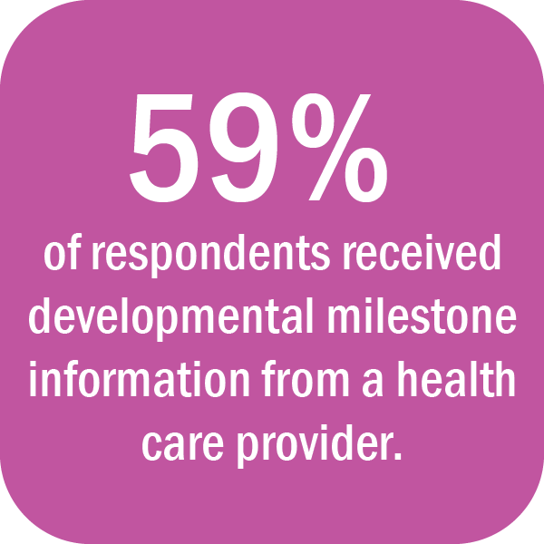
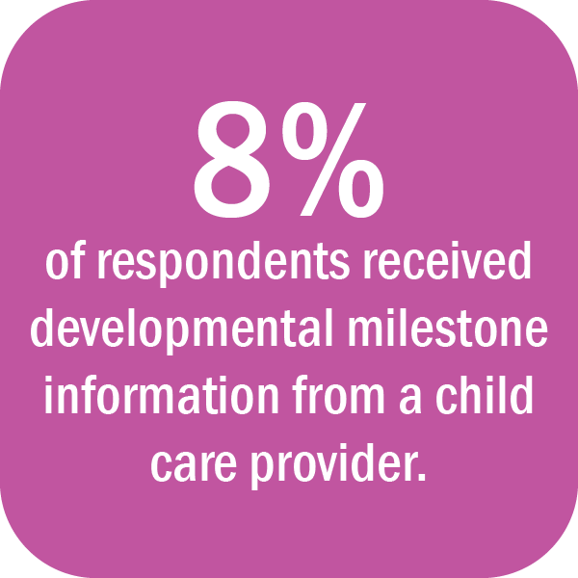
How are we marking developmental milestones?

Slide 5
How are we supporting children?
Developmental Health Promotion from Health Care Providers
During the past 12 months, have you received advice from a health care provider around... | Percent | 95% CI
Daily reading, talking, or singing to your child? | 43% | (39%-47%)
Daily interactions or relationship with your child? | 51% | (48%-55%)
Screening your child for any development, communication, or behavioral concerns? | 34% | (31%-38%)
Helpful community resources to support your child’s learning and development? | 41% | (37%-45%)
Community resources to meet your families’ needs? | 43% | (39%-47%)

Slide 6
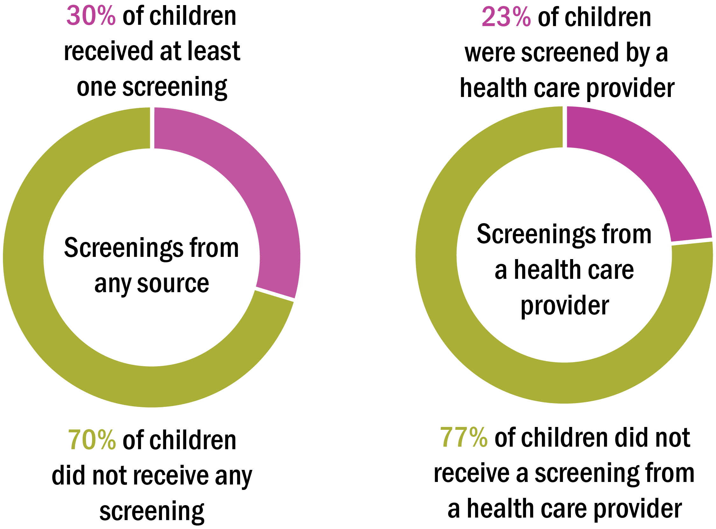
How are we marking developmental milestones?

Slide 7
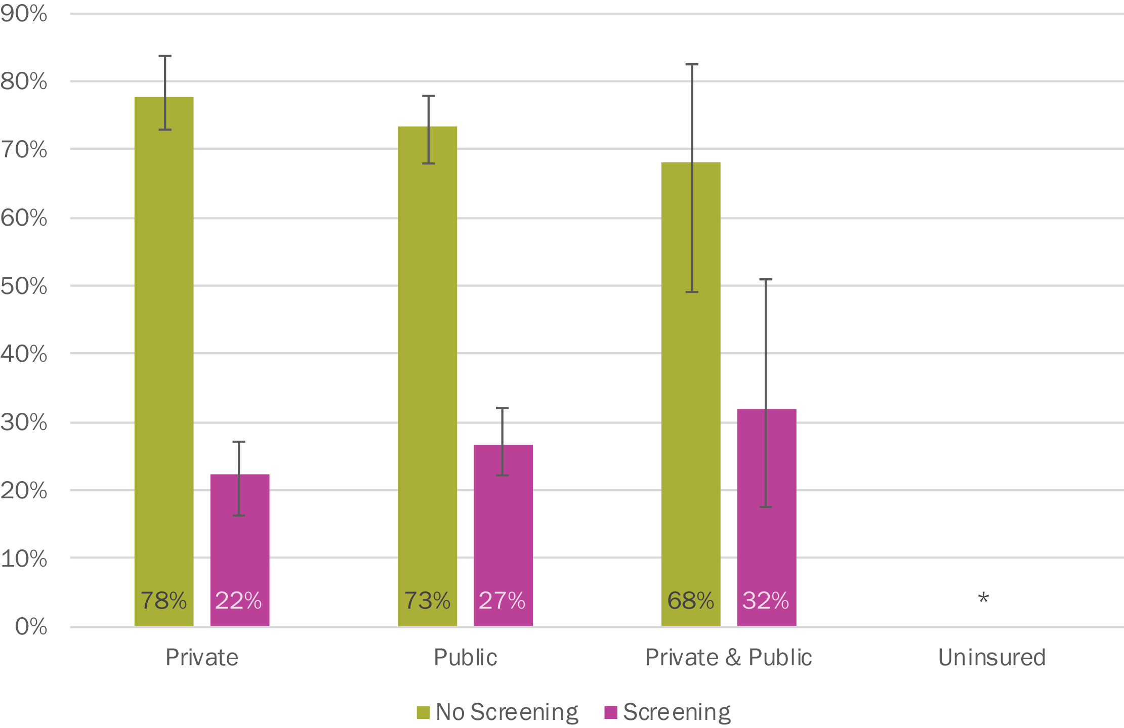
How are we marking developmental milestones?
Rate of Developmental Screening from a Health Care Provider, by Insurance Status

Slide 8
How are we marking developmental milestones?
Rate of Developmental Screening from a Health Care Provider, by Race

Slide 9
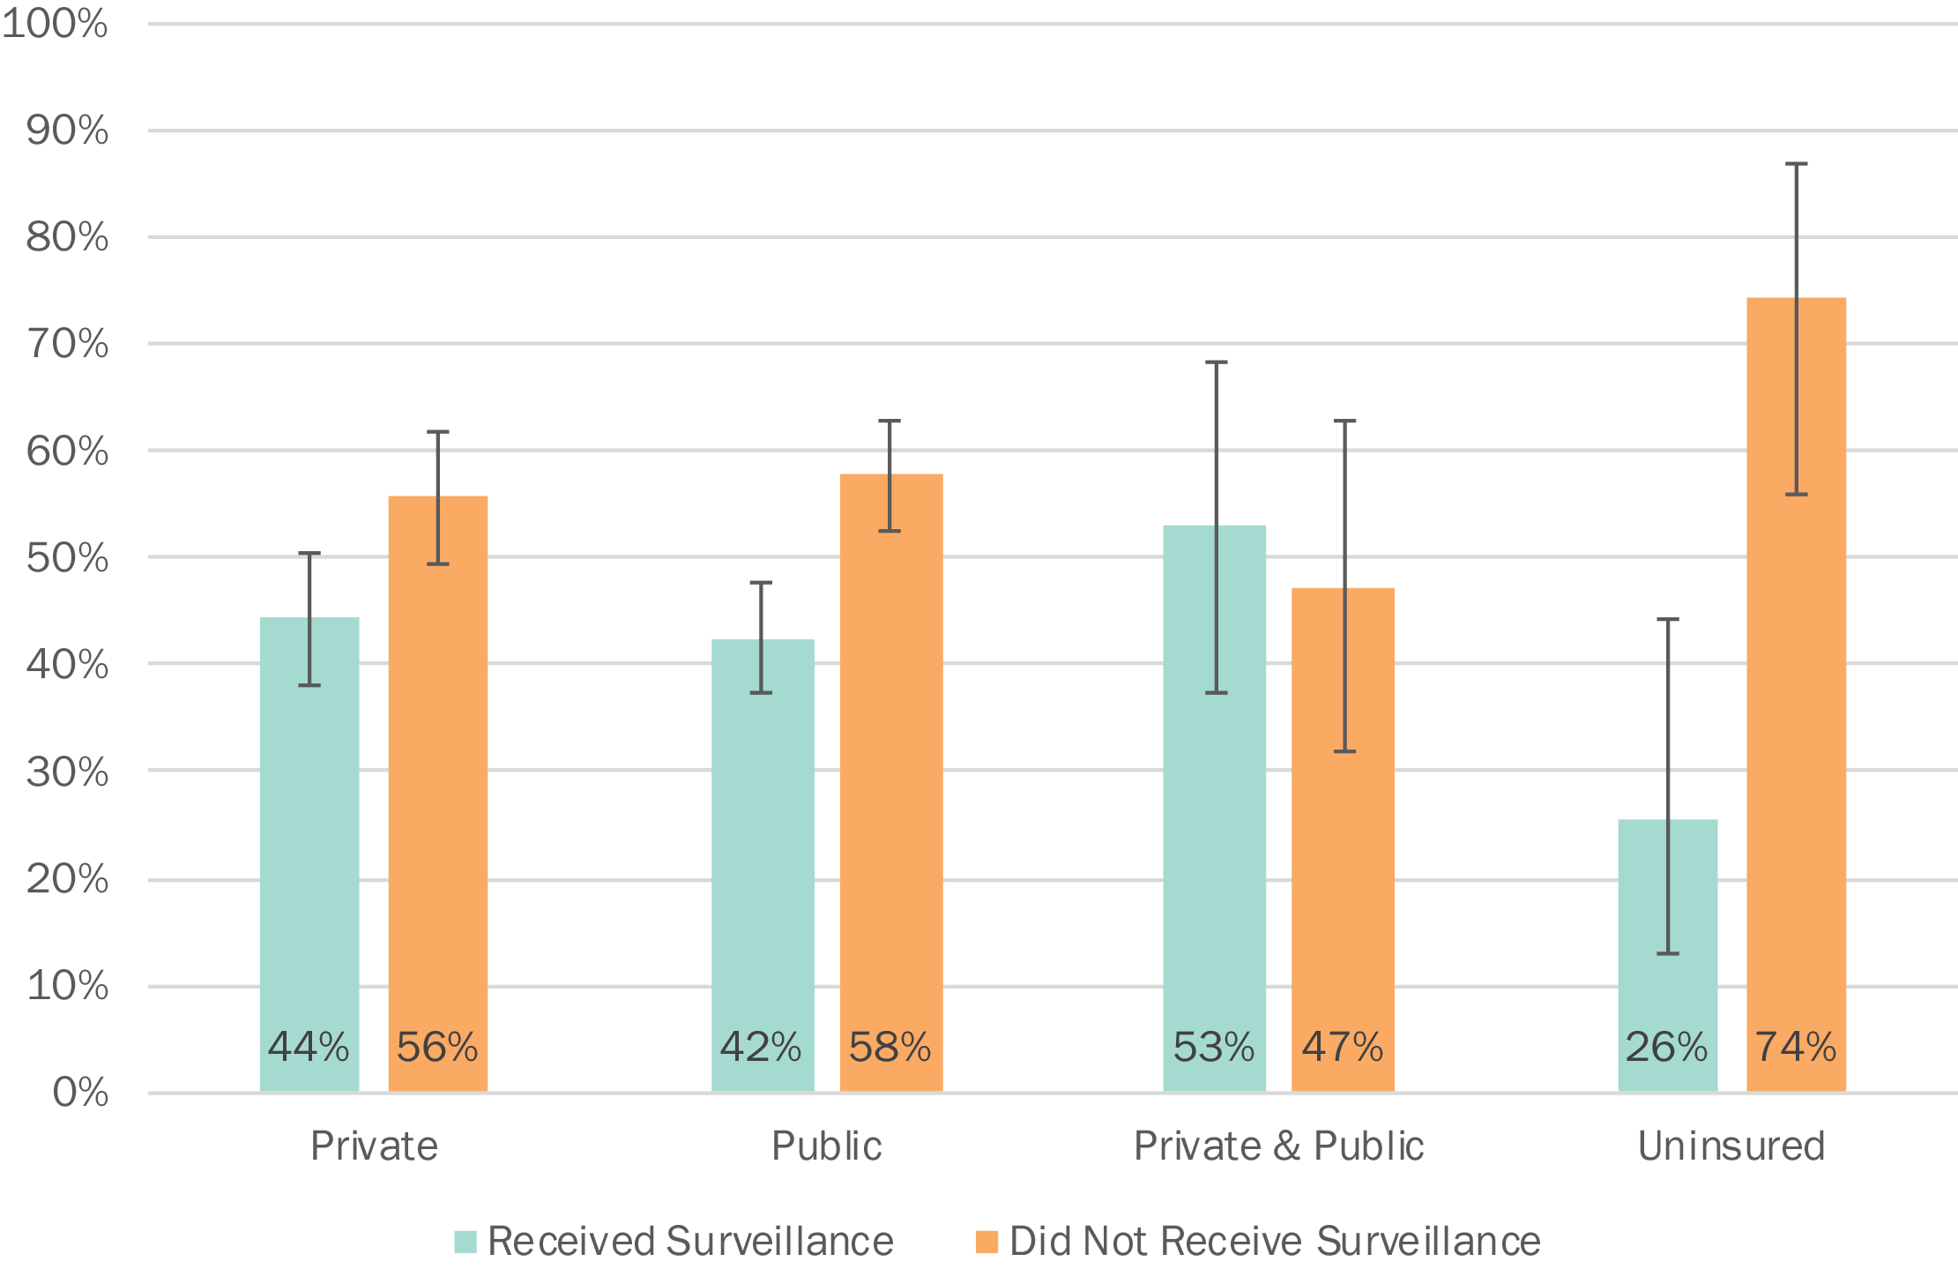
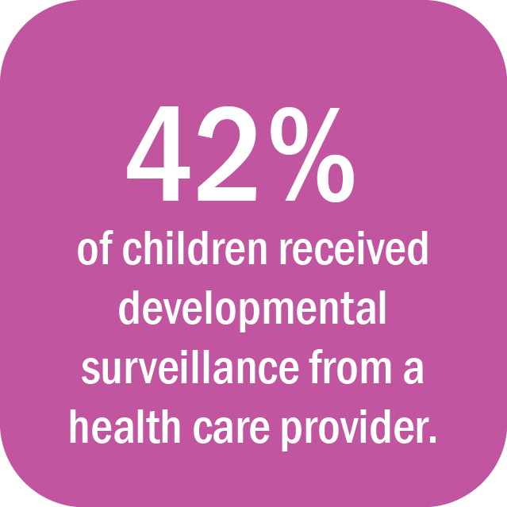
How are we marking developmental milestones?
Developmental Surveillance Rates from Health Care Providers, by Insurance Status

Slide 10
Summary
We know there are things that can hamper optimal development like adverse childhood experiences.
However, the biggest need we have is to actually monitor how kids are doing developmentally!
Fewer than 3 in 10 are being screened now
Fewer than half even get a cursory question from a doctor about developmental health concerns
Can provide the needed supports and avert unnecessary costs if we catch problems early.

Slide 11
How can we support providers
Increase Medicaid managed care organizations’ accountability for ensuring children receive developmental screenings at EPSDT wellness checks
Expand the use of telehealth services to link primary care providers to developmental health specialists
Increasing Medicaid support for statewide pediatric care coordination services.

Slide 12
Contact Information
Ben Walker
Project Manager
Social Science Research Center
Mississippi State University
Email: ben.walker@ssrc.misstate.edu

