Slide 1
POWERING THE FUTURE, TOGETHER.
Accelerating Progress for Children and Education in Mississippi Prepared in partnership with
The Harwood Institute for Public Innovation

Slide 2
It’s NOT rocket science.
What Mississippi families want for their children is similar, no matter their race, socio-economic status,
or geographic region.
Notes:
Most folks in the early childhood development and education sphere in Mississippi KNOW what our kids need. More access to support earlier, higher quality education and care options, more enrichment opportunities, funding for programs that help young kids…. But one thing that we didn’ know (for sure) was what Mississippians actually WANTED for their childrens. That’s why we partnered with the Harwood Institute for Public Innovation to create a qualitative report about Mississippians and our aspirations for children. We wondered what we would learn if we took some time to listen to families and educators.
What we learned wasn’t all that surprising to many people like you who work in the early childhood field and see the gaps, concerns, and issues families with little children face on a daily basis.. What we heard isn’t groundbreaking, BUT the fact that we listened to families and started with their perspectives is different than the way most of us operate, AND gives us an additional toolkit to use when communicating about our programs to families, to policymakers, and to funders. What families, educators, and leaders want for our children isn’t all that different no matter our race, geography, or first language, or political party, AND what they want isn’t all that hard to achieve.

Slide 3
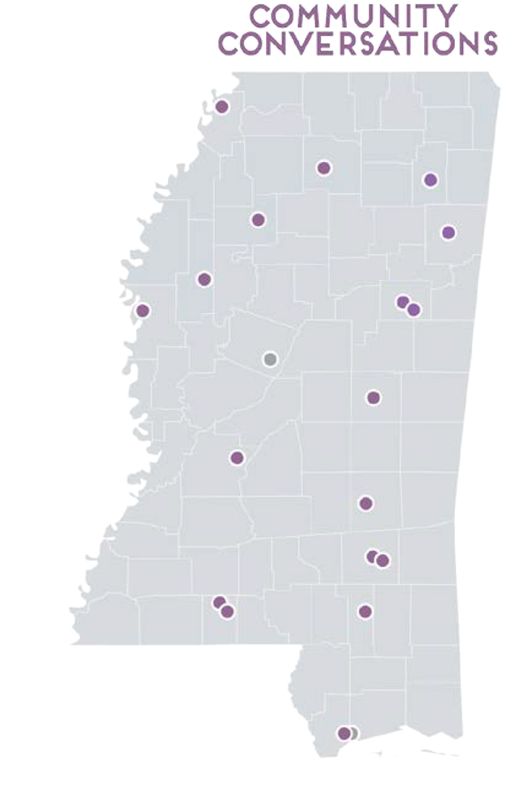
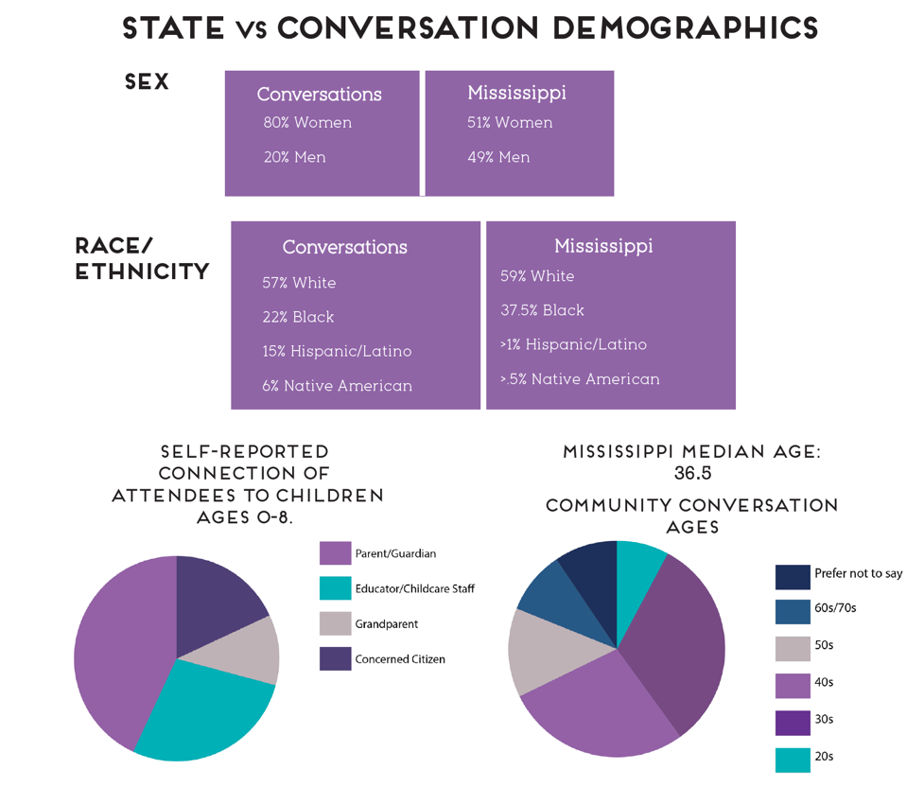
Notes:
When we set out to gather this qualitative information and perspectives of Mississippians, we intentionally considered who we wanted to hear from… we wanted the representation to be as close to the actual representation of Mississippi’s demographics as we could make it, in terms of race, geographic, socio-ecnomic status, etc.
We didn’t succeed entirely, BUT we did try, and we were able to hear from two groups who are often entirely excluded from conversations in Mississippi about education… The Choctaw community and the Latinx community. Our conversations were HEAVILY skewed towards women attendees as well, which wasn’t a surpose considering the subject matter. We did work to recruit men to attend, however.
We sought this diversity of perspectives because we believed that if any recommendations were to be authentic and get traction, they had to actually represent the diversity of our state.

Slide 4
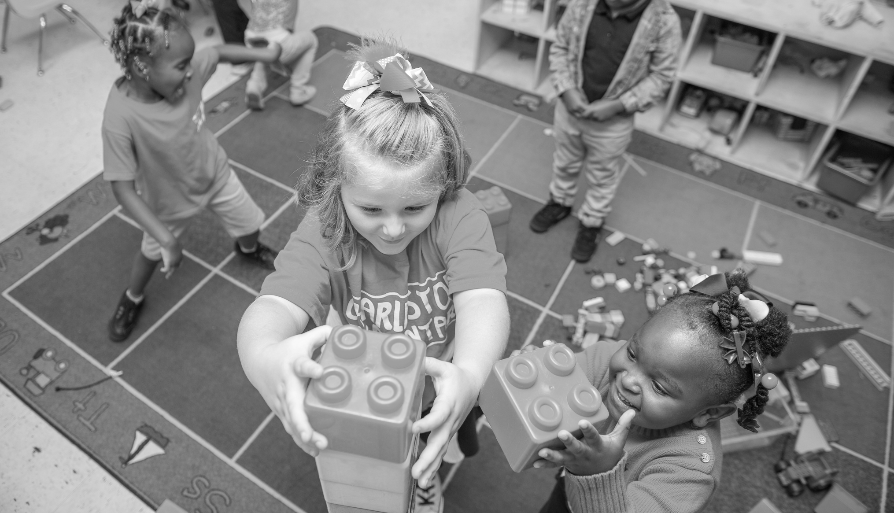
What We Heard
1. Build collaborative communities to support children
“I want a collaborative community—one where we work together to meet the needs of everyone. Where we know what people need and that there are needs. And that people feel comfortable and safe enough to share what they need. So, I guess... if they share with others, they won’t be judged but will be supported.”
2. Authentically engage parents as partners in education
“Kids don’t come with a manual. This is a learn-as-you-go experience…Support groups at every level are important.”
We have to start earlier for our kids to support them and to support parents who work. What happens if you work?”
Notes:
Here’s what we heard From Mississippians as far north as Tunica and as far south as Bay St. Louis. Mississippians want their leaders and organizations to
1. Build more connected and collaborative communities to support children and education.
add actual voices and quotes

Slide 5
What We Heard
3. Help educators understand and work with the local communities they serve
“The teachers don’t expect poor black kids to learn because that is what everyone expects.
And that is exactly what happens.”
“My child has learning disabilities and I struggle to get the school to keep supports in place as the staff and teachers are always changing.”
4. Make community resources available and accessible to all kids and families
“We don’t have the kind of transportation services we need to help people get to all the great stuff we have.”
“There is a lot available that people just don’t know about. We had a program right across the street and walked into the Laundromat one day and even though it could help their kids, no one knew about it. We have to do better at building awareness.”
Notes:
Here’s what we heard From Mississippians as far north as Tunica and as far south as Bay St. Louis. Mississippians want their leaders and organizations t
add actual voices and quotes

Slide 6
What We Heard
5. Get state priorities right on education and children
“We don’t have enough childcare because the state won’t reimburse centers for what it really costs.” The upshot? “Families are stuck piecing together care.”
“How come parents are allowed to wait to send their kids to school when they are 6 years old?”
Notes:
Here’s what we heard From Mississippians as far north as Tunica and as far south as Bay St. Louis. Mississippians want their leaders and organizations t
add actual voices and quotes

Slide 7
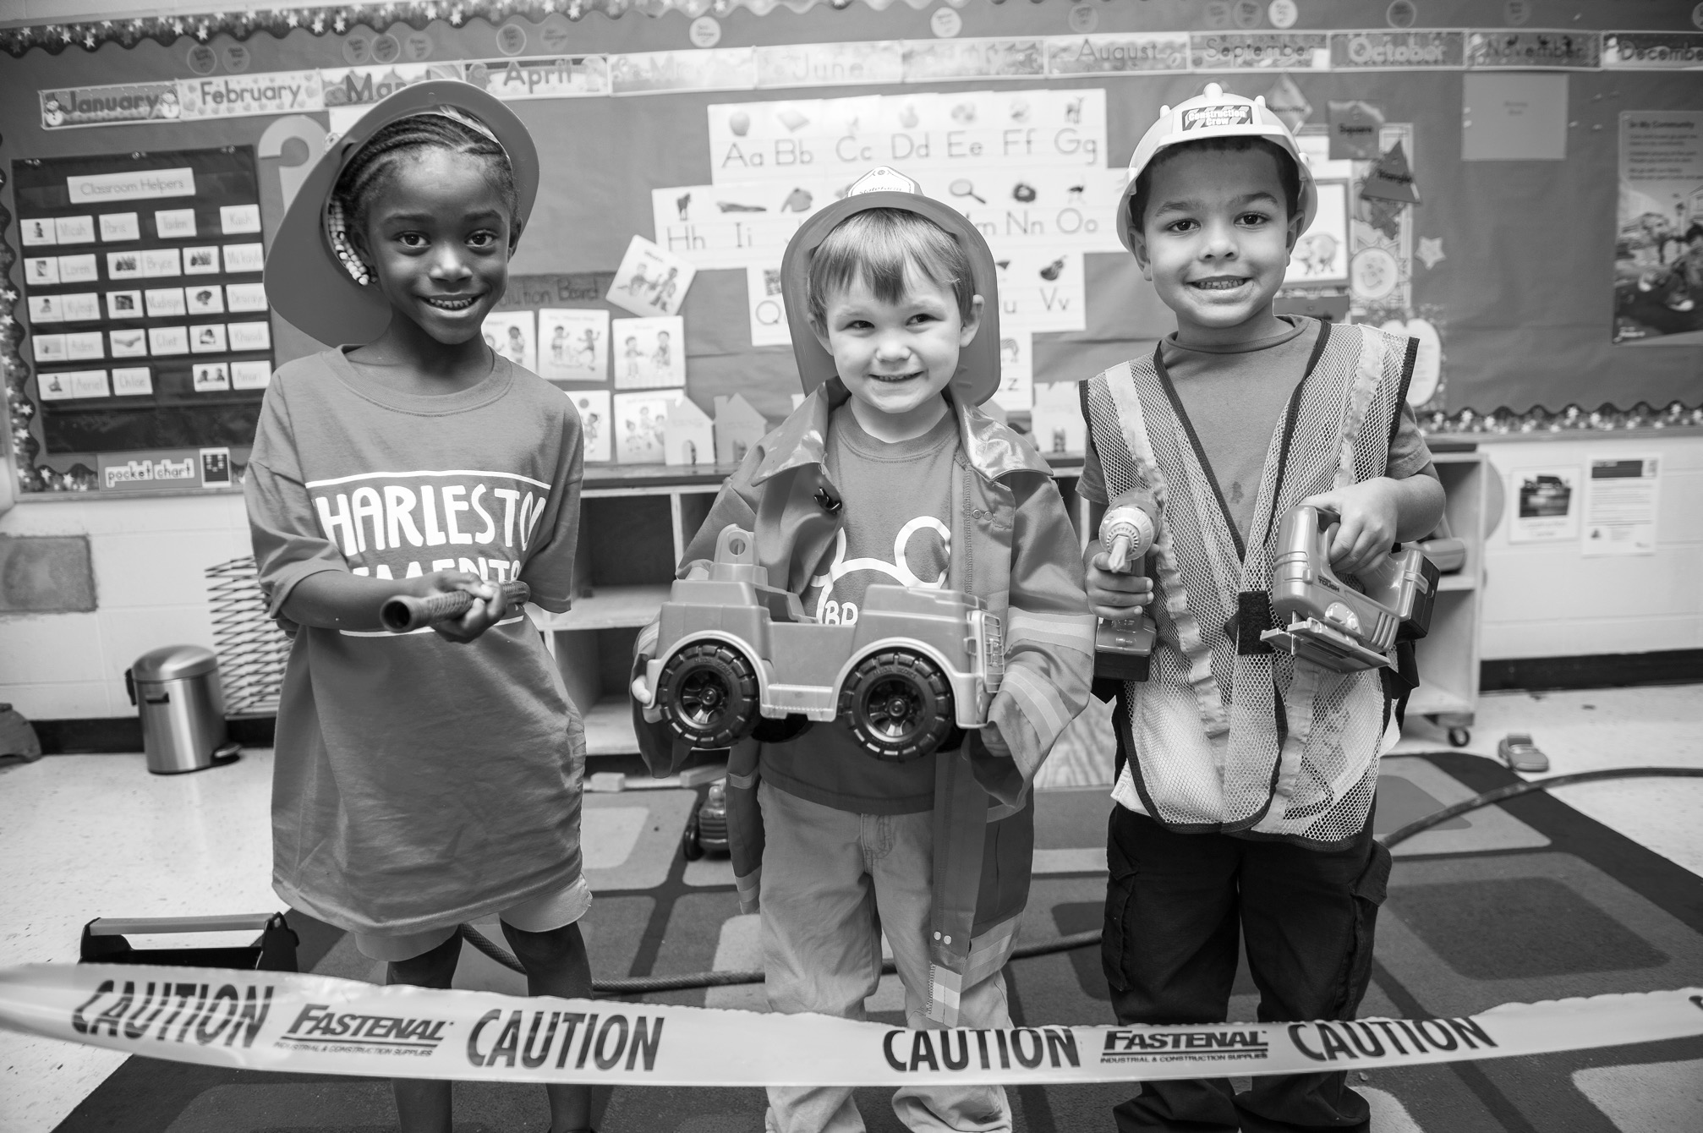
What Does this Mean for Us?
1. Refocus conversations on Mississippians’ aspirations for children
2. Bring people together to build SHARED responses
3. Connect people to existing resources
Notes:
So, what does this mean for us? How do we, as pediatricians, educators, organization leaders, policymakers use this information to make informed decisions, and positive systems change for our kids and families?
There were several takeaways from the report, which you can read in full on our website, but there are three we want to share with you today.
#1: Whenever we are working on a contentious issue, we have to make sure to refocus the conversation on Mississippians’ aspirations for our communities and children. Asking “What do we want for our communities and for children” is a great way to focus on people’s shared aspirations. It will not lead to people agreeing on everything that should be done; but it will enable people to find enough common ground and forge a common language for moving forward. And it will refocus people on what they are for—not simply what they oppose. This is a prerequisite for opening up the discussion and generating productive and sustainable action.
ADD example from this report thinking about the problem with parents VS the aspirational goal. For example, if you review the quotes we gathered from the people who attended conversations, what we see is that they spoke about what is MISSING…but we reframed it in terms of what people WANT. It’s not that we DON’T like what’s happening with parents, it’s that we DO want them to have more support.
#2 So often, as individuals, as organizations, as entities we see a problem and we rush to find a solution. However, we heard that people are ready to come together to build the solutions collaboratively. This collaboration won’t be easy, but will begin to foster trust and connections between government entities, educators, organizations, and families, which sets the stage for larger, more systemic positive changes in the future.
#3. Recently a friend moved back to her hometown with her family. She searched,she asked, and she explored all she could to find out what resources, activities, and events were available for her children. Finally she found a music class for her then-3 year old. Within a year or two she was made aware of some local museum programs and a HUGE community event that she couldn’t wait to take advantage of but had missed that year. She wasn’t the only one… she learned that the event was never full and only attended the in-the-know of the community. In fact, the community organization that hosted the events complained that though they invited the people of color in the community, they never came.
By relying on word of mouth and social media, these local organizations were missing out on an audience of people who weren’t connected in the same way. This is a HUGE theme that we heard…. If community resources exist, we’ve GOT to make sure EVERYBODY knows about them. We can’t rest on laurels but have to put in extra effort to be sure that the members of our communities who are often overlooked and disenfranchised have access and knowledge, too. We also have to know how people from different backgrounds

Slide 8
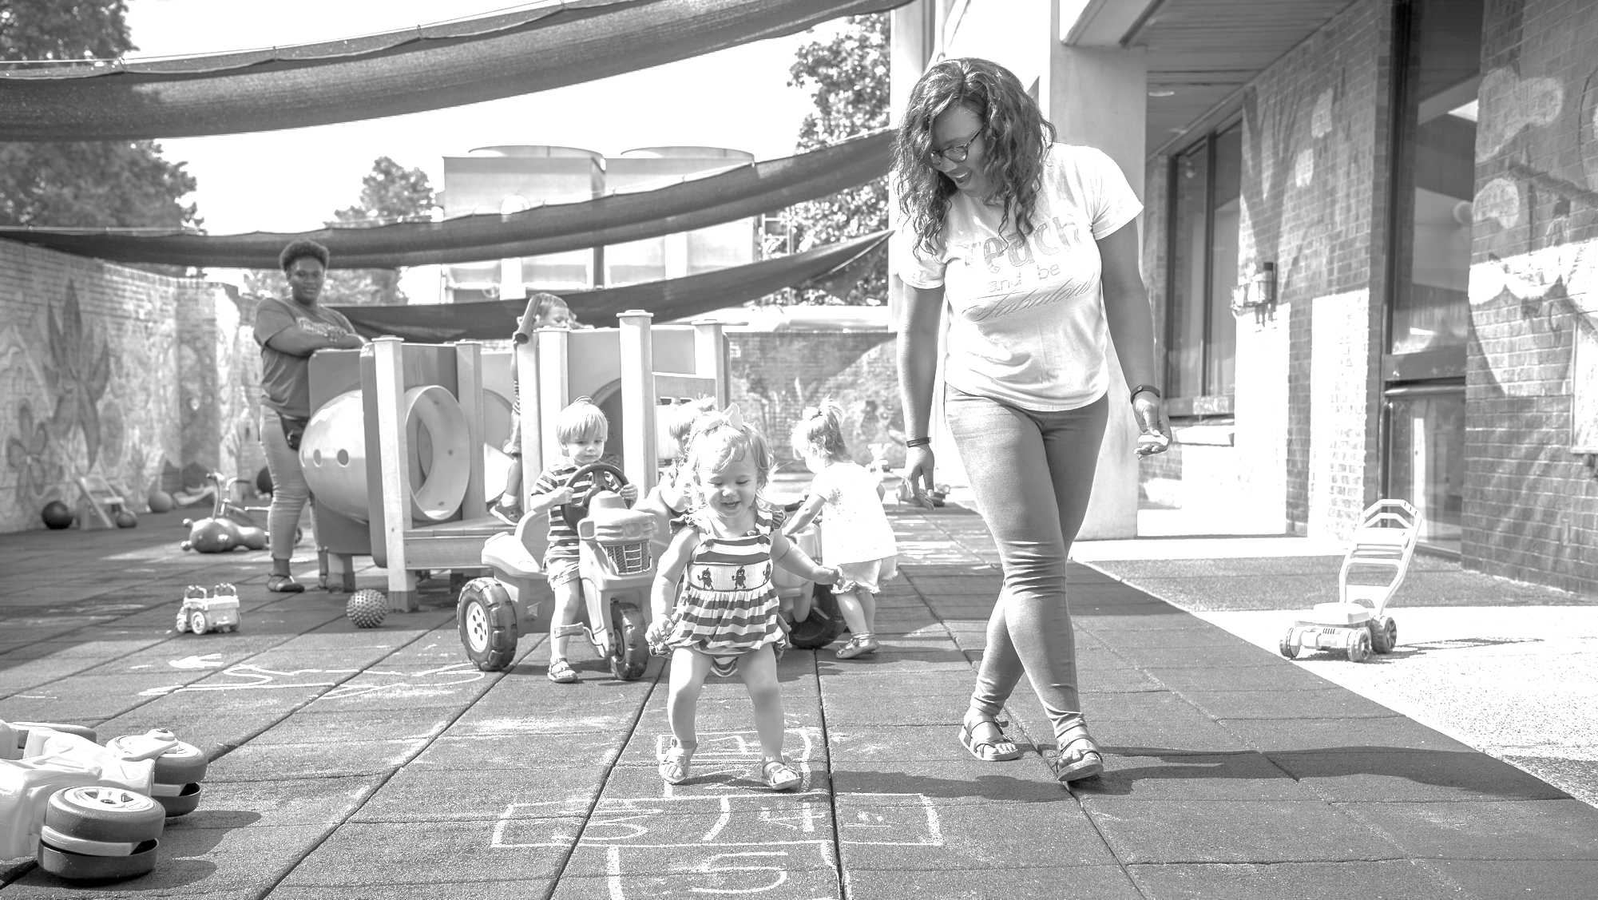
What does this look like?
Consider one of your current programs, policies, or issues. Is it framed with aspirations in mind?
How is your organization currently solving problems and developing programming?
Who currently accesses your organization’s resources? How might you rethink delivery to increase equitable access?
Notes:
What does this look like in practice? Give some examples.

